Slide 1

Gokaraju Rangaraju Institute of Engineering and Technology (Autonomous) Department of Artificial Intelligence and Machine Learning Engineering
Enhanced Automated Word Formatter
Under the Guidance of:
Dr. M. Kiran Kumar,
Associate Professor, Dept of AIMLE
Presented by:
1. Mr. N. Krishna Kalyan (20241A6638)
2. Mr. A. Abhinav (20241A6605)
3. Mr. Samuel (20241A6647)

Slide 2
ABSTRACT
Researches face a lot of problem while documenting their Manuscripts. In absence of proper formatting, the research paper may get rejected, even if it has quality content. The aim of project is to create an application to streamline the process of transforming documents into various recognized academic or professional styles, ensuring consistency and precision. The proposed application is useful for a wide range of usecases, from Research papers to Academic Thesis, which effortlessly manages titles, headings, text, tables, figures, equations and also presents the content in an organized and professional manner. Additionally, it automates the handling of Citations and References, significantly enhancing the document preparation efficiently across various formatting standards. The proposed application is constructed by modifying the nodes of the document tree structure. With this versatile application, valuable time and effort can be saved while ensuring the documents adhere to the highest standards of formatting.

Slide 3
PROBLEM STATEMENT
Research industry face rejection due to poorly formatted manuscripts. Our project aims to create an application simplifying document formatting, ensuring consistency, and saving time. It addresses the challenge of automating style elements like Titles, Images, and Tables for academic papers.

Slide 4
OBJECTIVES
To Implement a python-based word formatting tool which automates manual editing to save time and effort. ​​
Applying a pre-defined style to the categorized elements through manipulation of the Document Tree Structure.
To implement approaches for formatting text, images, and tables
To enable specific styling techniques for each element.

Slide 5
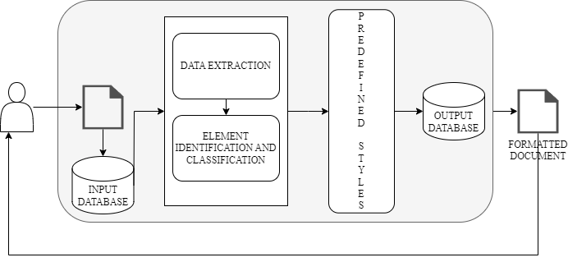
Proposed Architecture Diagram (phase – I)
DJANGO FRAMEWORK
USER
DOCUMENT

Slide 6
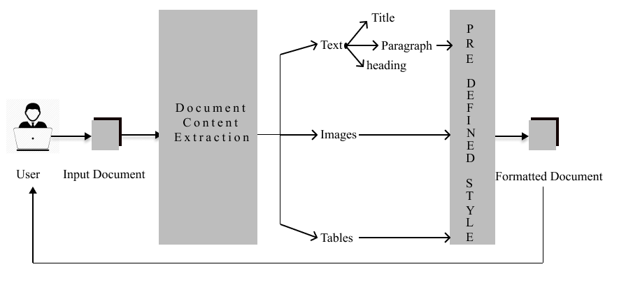
Architecture Diagram (phase – II)

Slide 7
Modules
User Module
File Upload and Download: Enabling users to upload Word documents and download formatted documents.
Feedback : Allows users to send there feedback and suggestions on how well the document is formatted.

Slide 8
Input and Processing Module
File Upload Handling: Receiving and validating uploaded Word documents.
Data Extraction: Extracting data from Word documents, including text and document structure.
Data Preprocessing: Cleaning and formatting extracted data, removing extra spaces, and ensuring data consistency.

Slide 9
Predefined Style Application Module
Layout Adjustment: Ensuring that the document layout complies with research paper standards.
Style Consistency: Applying consistent styles throughout the document by using regular expressions.
Output Module
Formatted Document Generation: Generating a properly formatted Word document with the applied styles.
File Download Handling: Serving the formatted document to users for download.

Slide 10
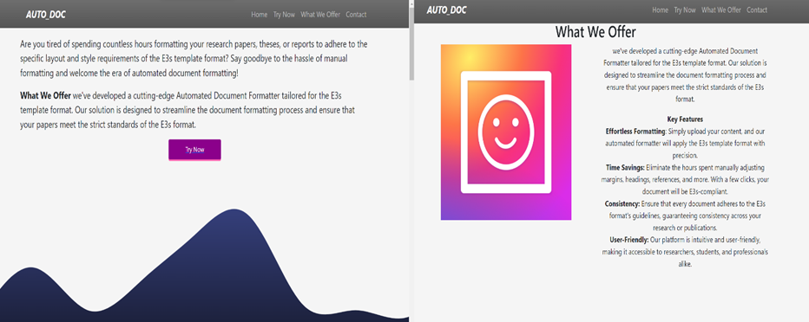
EXECUTION
The above image illustrates how the user interface is provided to the user.

Slide 11
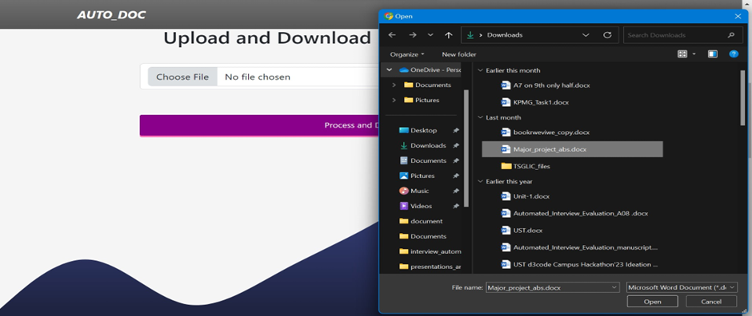
The above process shows how to upload a document file of the user.

Slide 12
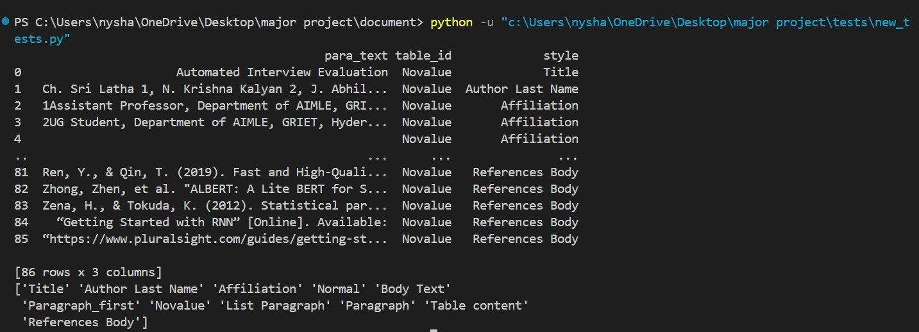
The above image is an intermediate process which demonstrates how the elements are classified internally within the document.

Slide 13
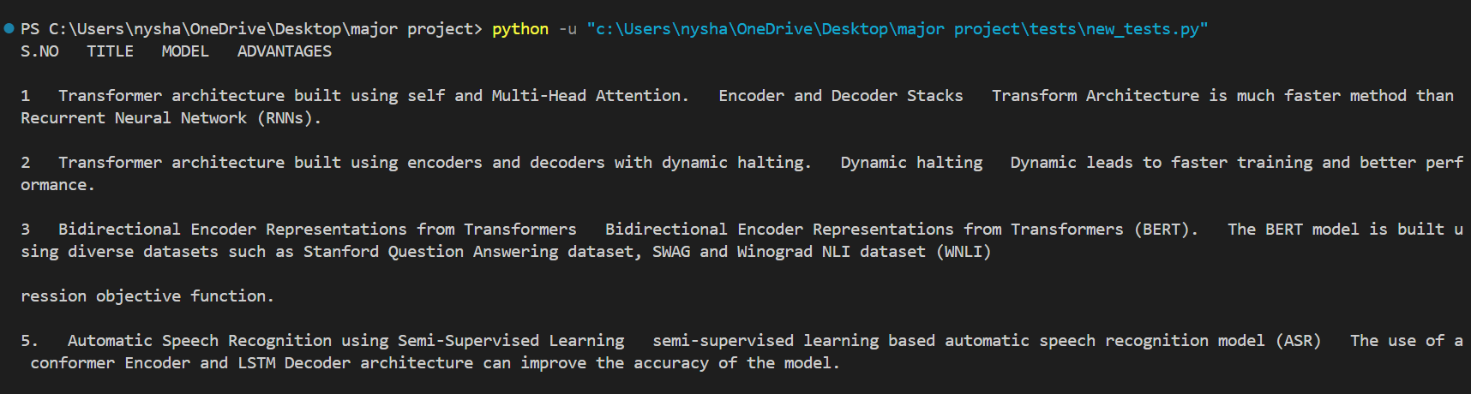
The above image is an intermediate process which demonstrates how the table data is extracted and stored in the form of a data frame.

Slide 14
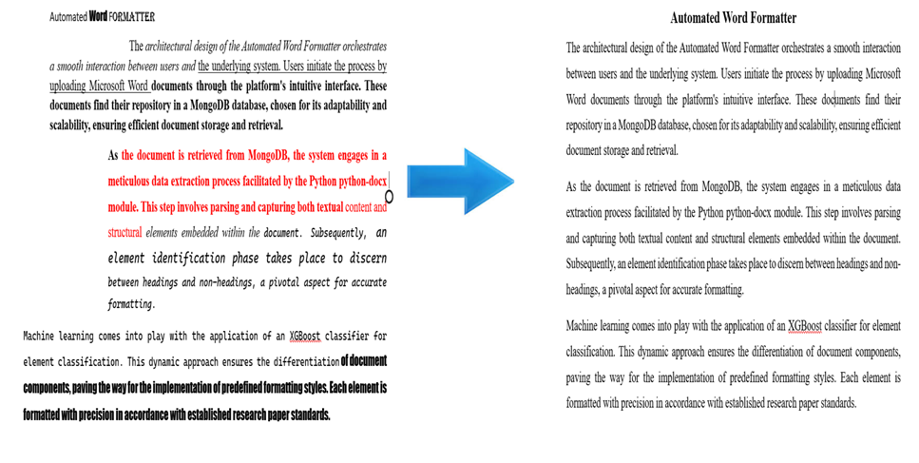
A sample on how the project works taking the raw document and converting it into a Formatted document

Slide 15
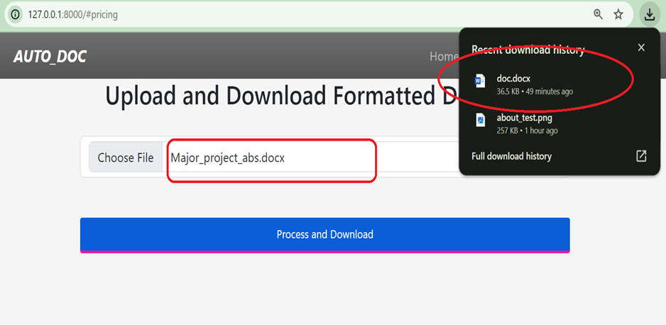
Once the document is uploaded the formatted document will be automatically downloaded as illustrated above.

Slide 16
Conclusions
The Automated Word Formatter stands as a transformative solution, rendering document formatting a hassle-free. Users experience seamless formatting magic by effortlessly uploading their documents to the platform. This marks a significant shift, making the once tedious task of formatting documents a breeze. One of the standout features is the platform's commitment to delivering an effortless formatting experience.

Slide 17
FUTURE ENHANCEMENTS
These advancements can be addressed ahead in future
Additional Document Formats: Extend support beyond DOCX to include other popular document formats, ensuring a broader user base.
Collaborative Editing: Implement collaborative editing features to enable multiple users to work on a document simultaneously.
Enhanced Error Handling: Improve error handling mechanisms to provide users with clear feedback in case of formatting issues or document errors.

